Slide 1
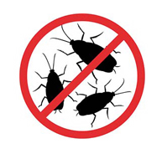
Better Living through Testing
An Introduction to Unit Testing with MXUnit
Marc Esher & Bill Shelton from MXunit.org
Notes:
Warm up. Introductions

Slide 2

About Us
Front-line CF and Java Programmers
40+ years combined experience
We built MXUnit to suit our own testing needs
http://mxunit.org
Marc, Bill, Mike, Raj, and Amir.
Bill can’t count very well.

Slide 3


What I love
My Girls
Not why I do what I do
Notes:
Not why I do what I do
They don’t know the difference between being good, and just good enough
That difference won’t affect pay, either
For them, all I want is to be a great dad.
But that quest for excellence isn’t something you compartmentalize. It affects all of you.
Just like as a developer, I want to be really good. I don’t want to be average.
And I believe that the quality brought out in my code by more testing really helps get me there
And before I continue with the things I love, let me define unit testing:
Unit testing is code to test other code.

Slide 4
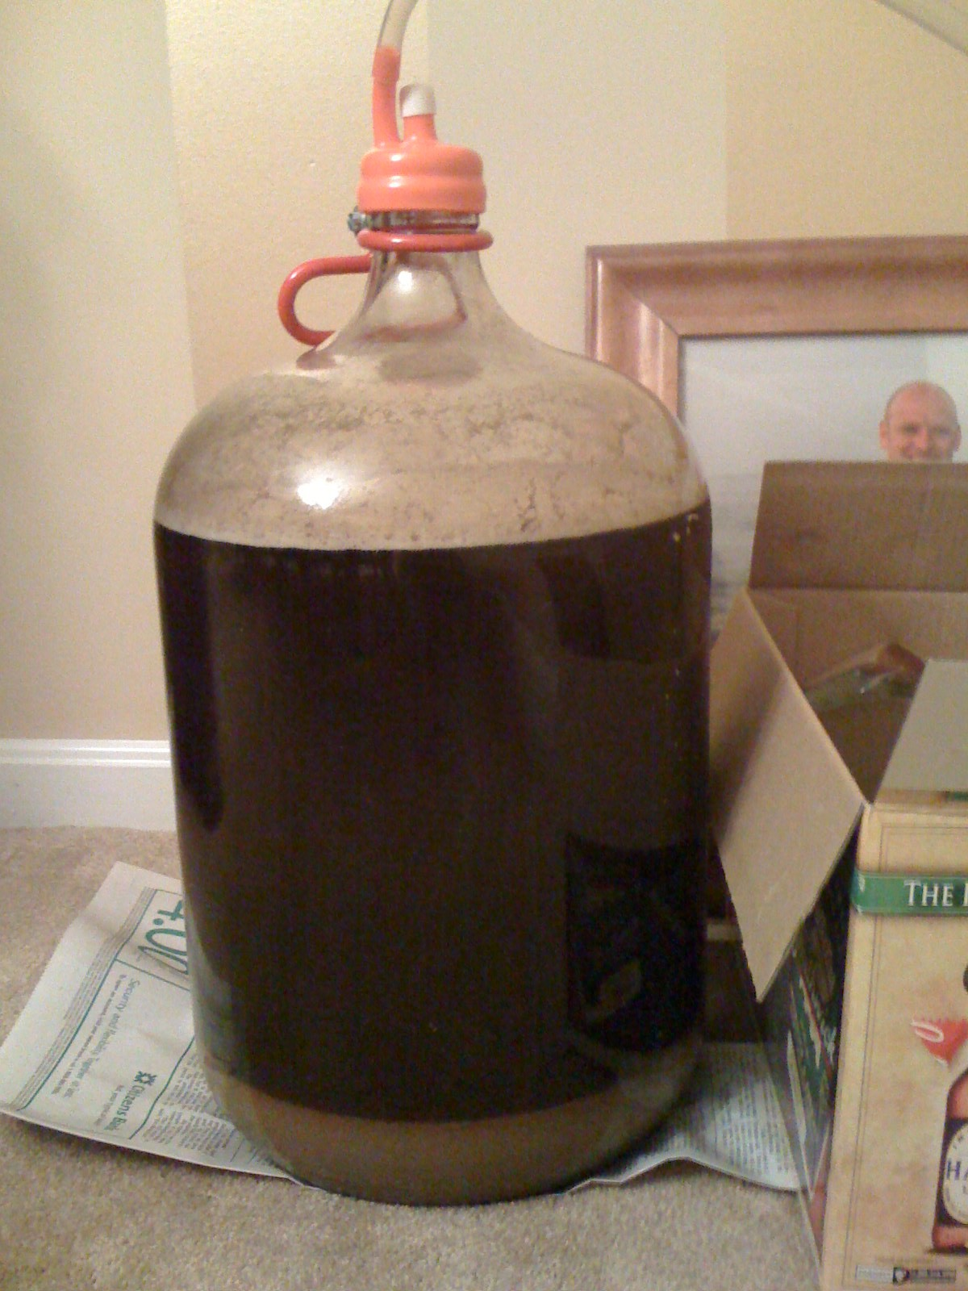
Craftsmanship
A Double IPA of my own design
Brewing is craftsmanship… just like coding
Notes:
When I brew, I brew not just for me but for the people who will drink this beer
I don’t want to give them crappy beer
In the end, I seek higher quality
One promise of unit testing is that it leads to higher quality software
Unit Testing isn’t new to CF, but it’s not a common practice.
But in other languages – Java, Ruby – it is common practice.
Tell story of woman in java class who was professional test writer

Slide 5
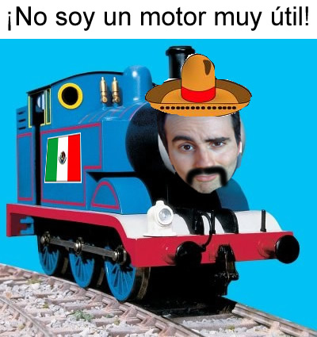
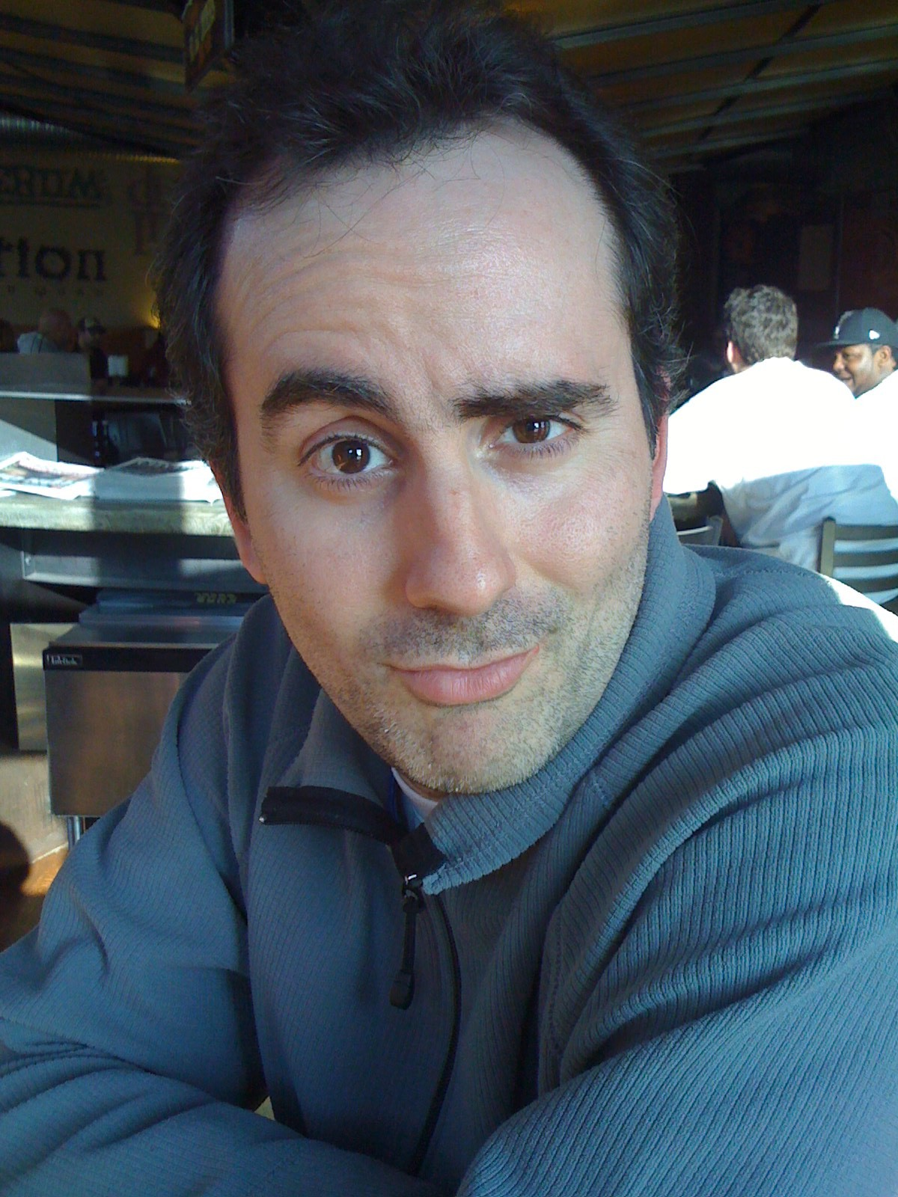
Team
A guy named Ken
This guy has to use my code!
Notes:
I write a lot of software that people on my team use
I want to help them kick ass.
I want their job to be easier.
It just so happens that the easier I can make it for them to use my code, the easier it is for me to test that code.
Core concept in unit testing: Callable code is Testable Code.
Code that’s easy to test is also code that’s easy for other people to use.
Because as you write tests while you’re developing your API, you’re thinking “How do I test this code? How can I make it testable”? And this can improve the design of your code.
In that sense, tested code is self documenting code.

Slide 6



Customers
Helping these people kick ass (or, at least, get their work done)
*Pictures shamelessly taken from the internets
Notes:
e do not write software in isolation
Somewhere, a user is going to use it
We’re helping them do some job, and we want to help them do it well
One big hope with programmatic testing is that you can automate enough of it so that you can expend your human testing effort on the harder stuff
It’s not a cure all. It’s not a big fluffy security blanket. It doesn’t mean you don’t test.
But programmatic testing can help you ensure that bugs are caught earlier in the process. It’s a whole lot easier to fix a bug you catch 2 months before launch than 2 hours before launch
Blogger Kathy Sierra says it’s our job to help our users kick ass. Get them over what she calls “the suck threshold” and help them get their jobs done. That creates passion in our users for our software.

Slide 7
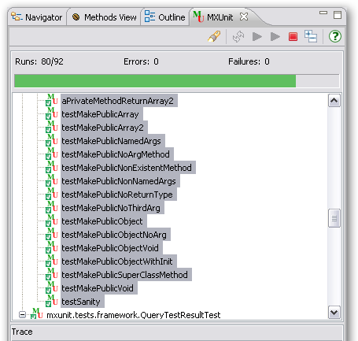
Back to Green
Green = passing tests
High “Runs” means I’m writing lots of tests
Notes:
Green is good
Green means passing tests
High Test runs means more of my code is under test
You’ll never get 100% coverage. I don’t think you should try. But the higher your coverage, the hope is that the better off your codebase is
Higher the quality of your coce, one hopes, the more productive your teammates are who have to work with it and the happier your customers are who have to use it
NEXT SCREEN IS CF ERROR SCREEN

Slide 8
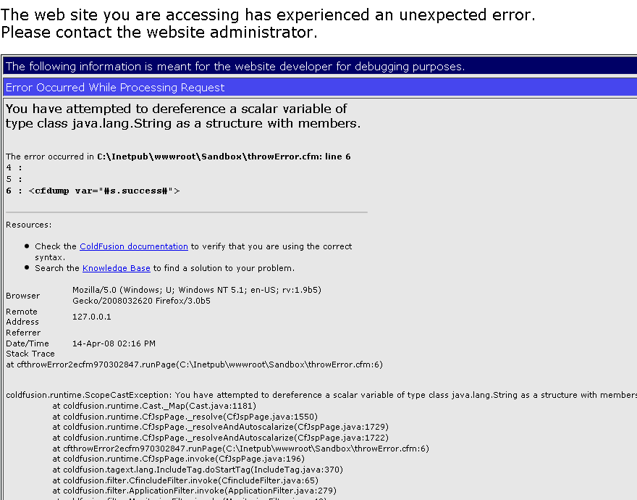
Things I don’t like
CF Error Screen
Notes:
We’ve all seen this a thousand times
It means something went wrong.
Eventually, as you grow as a test writer, you’ll get into the habit of writing tests for bugs. So you get a bug report, first thing you do is write a test that proves the bug exists
Once you do that, you work on fixing the bug. When your test passes, changes are you have fixed the bug

Slide 9
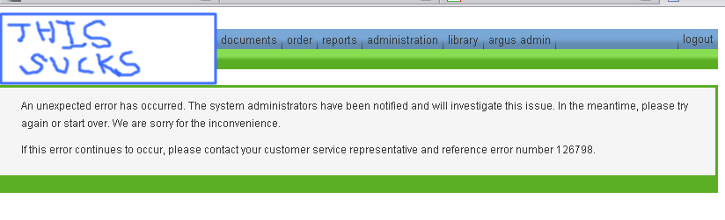
When the user sees this
“custom” error template
Notes:
Our “error template” where I work
If unit testing can keep just one customer from seeing this screen… If it can catch one bug… that’s a step forward
He turns from that happy customer from a few pages back
Into this guy…. (next screen)

Slide 10
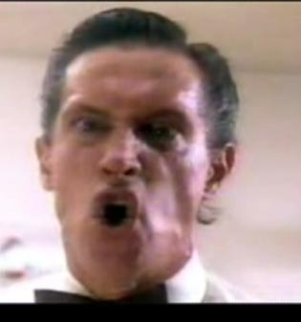
Guy, 2 seconds later
User after seeing the custom error screen
Mark Metcalf, Twisted Sister “I wanna rock” video
Notes:
When he’s like this, he’s not kicking ass.
He’s not happy about your software.

Slide 11
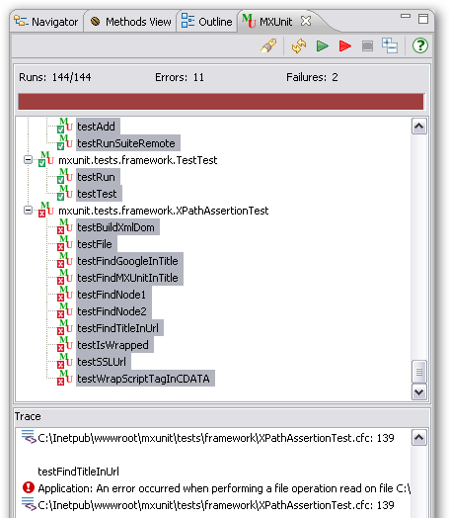
Red again
Red = failing tests
But at least I know what to fix!
Notes:
This is the MXUnit view again
This time, I have some tests that failed or errored.
Good thing is that if it’s failing or erroring, at least I have a test that caught the problem.
And then I am ahead of the game in trying to fix the problem
Because I know that when those tests turn from red to green, I’ve fixed the bug

Slide 12
Meat and Taters
Code Time
Code Questions
Back to your Corner
Jive Turkey (lingo matters)
To Shiv or Shank? (naming matters)
How you test
Why a test framework?
Why MXUnit?
6 Simple rules for writing tests
How to run tests
Why I love to test
Notes:
Code Questions
------------------------------------------------
--What’s the name of the CFC we’re testing?
--What does that CFC do?
--What are some of the validation rules?
--Would “password” pass?
--How about “pass w0rd1”?
--Would “?” pass? Why don’t you know?
--If you were a programmer using PasswordValidator, how would you get a user-friendly message about why the password failed?
Finally: How does PasswordValidator work?
MAJOR POINT: you hope your tests don’t need to know implementation details ------ This is encapsulation
Back to your Corner
----------------------------------------------
--We read no docs
--Looked at no API
--Didn’t open the PasswordValidator.cfc file itself to see how to use it
--Didn’t search the file system for instances of PasswordValidator to find out how it’s used in other code
--Easy to test components are often easy to use --- You knew how to validate a password and output a message with just looking at a few lines of code
Point out that we didn’t test for similar passwords over and over ---- big point: spend your time on edge cases
Jive Turkey
-------------------------------------------------
TestSuite – collection of TestCases
TestCase – collection of Tests
Test – Collection of Assertions
Assertion – demonstrate expected behavior
setUp
tearDown

Slide 13
Why I test
Less of this…

Slide 14

Why I love to test
… and More of this

Slide 15
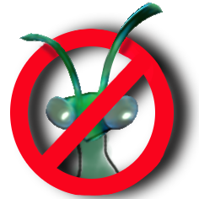
Thanks!

